Slide 1

Predictive Analysis Approach for Stroke Prediction using various Machine Learning Algorithm and Neural Networks
Project Presentation
By
SAKET TRIVEDI
AALIND KUMAR SINGH
NEHA ANWEKAR
Notes:
To use this title animation slide with a new image simply 1) move the top semi-transparent shape to the side, 2) delete placeholder image, 3) click on the picture icon to add a new picture, 4) Move semi-transparent shape back to original position, 5) Update text on slide.

Slide 2
DATA SCIENCE LIFECYCLE
01
Problem Statement
02
Data Mining
03
Data Cleaning
04
Data Exploration
05
Feature Engineering
06
Predictive Modeling

Slide 3
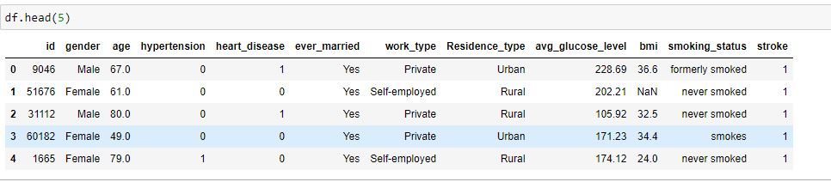
Problem Statement & Data Mining
Attribute Information
id: unique identifier
gender: "Male", "Female" or "Other“
age: age of the patient
hypertension: 0 if the patient doesn't have hypertension, 1 if the patient has hypertension
heart_disease: 0 if the patient doesn't have any heart diseases, 1 if the patient has a heart disease
ever_married: "No" or "Yes“
work_type: "children", "Govt_jov", "Never_worked", "Private" or "Self-employed“
Residence_type: "Rural" or "Urban“
avg_glucose_level: average glucose level in blood
bmi: body mass index
smoking_status: "formerly smoked", "never smoked", "smokes" or "Unknown"*
stroke: 1 if the patient had a stroke or 0 if not
According to the World Health Organization (WHO) stroke is the 2nd leading cause of death globally, responsible for approximately 11% of total deaths.
This dataset is used to predict whether a patient is likely to get stroke based on the input parameters like gender, age, various diseases, and smoking status. Each row in the data provides relevant information about the patient.

Slide 4
Existing System & Gap on Existing System
Machine Learning and Neural Networks approach.
Age, Heart Disease, Average Glucose Level for Predicting Stroke.
Stroke Risk Prediction Model For African Populations using conditional logistic regression.
Prediction of Upper Limb use Three Months after Stroke using linear as well as logistic regression.
Machine Learning techniques can provide an early and low cost diagnosis.
Several studies have analysed the importance of lifestyle types, medical records of patients on the probability of the patients to develop stroke. Further, machine learning models are also now employed to predict the occurrence of stroke. However, there is no study that attempts to analyse all the conditions related to patient, and identify the key factors necessary for stroke prediction.

Slide 5
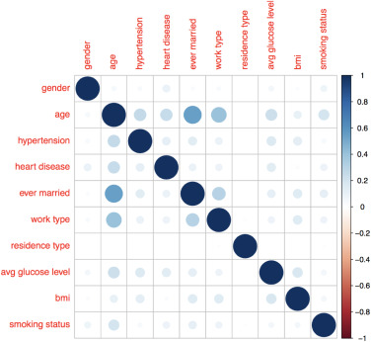
Machine Learning Algorithms
Problem Solution
!
In this project, we attempt to bridge the gap by providing a systematic analysis of the various patient records for the purpose of stroke prediction.

Slide 6
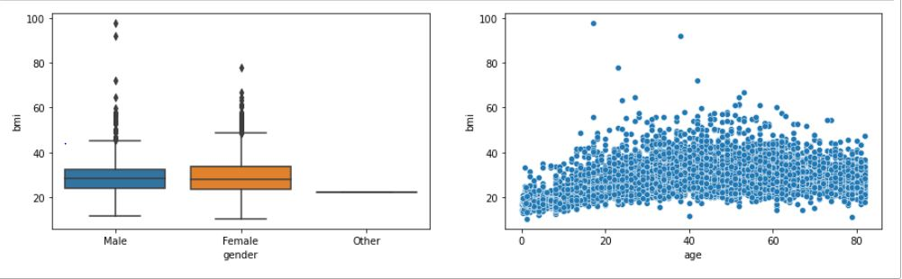
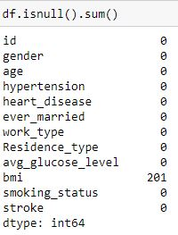
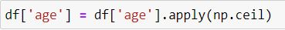
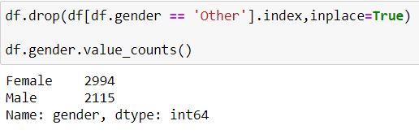
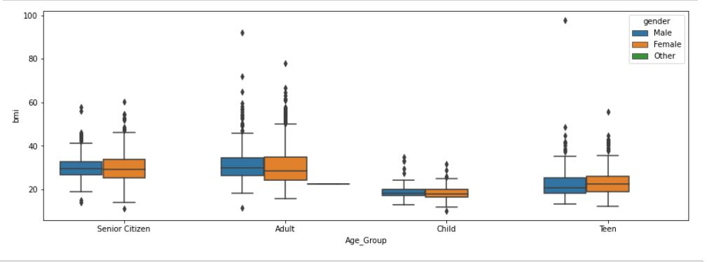
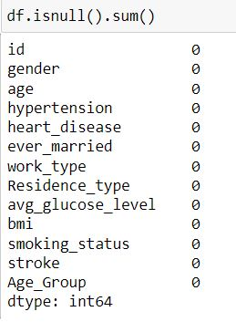
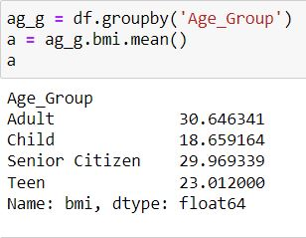
DATA CLEANING

Slide 7
EDA Exploratory Data Analytics

Slide 8
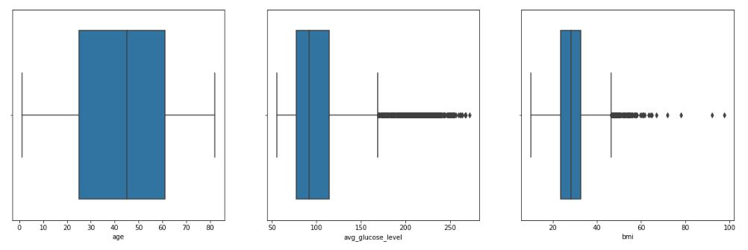
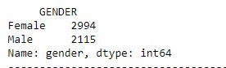
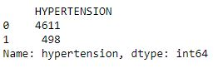
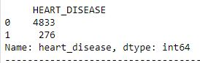
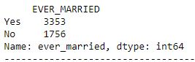
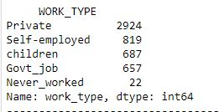
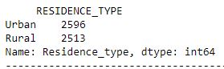
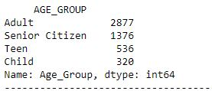
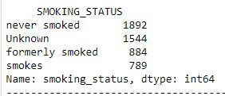
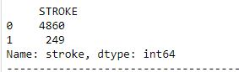
CONTINUOUS VARIABLE
CATEGORICAL VARIABLE

Slide 9
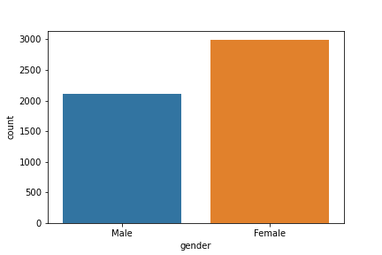
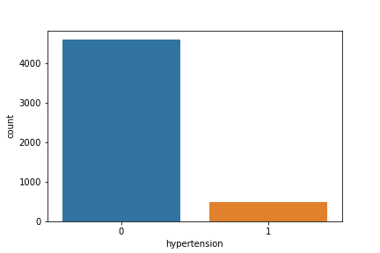
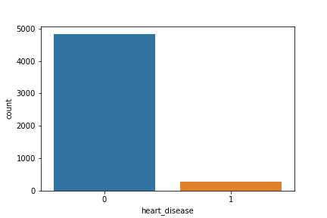
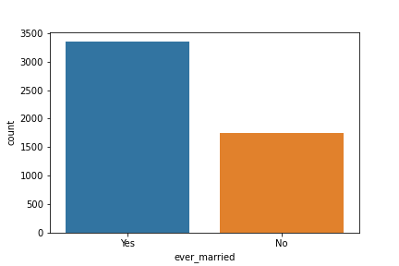
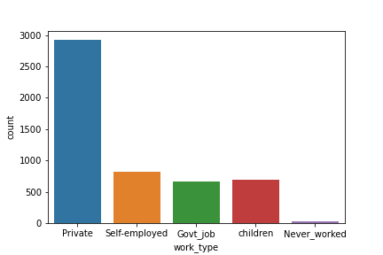
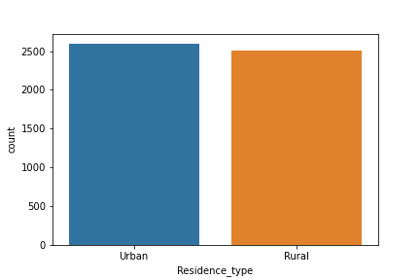
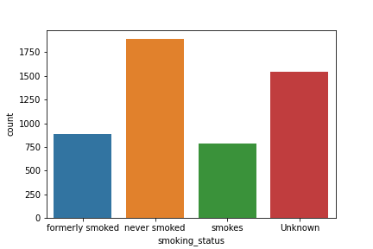
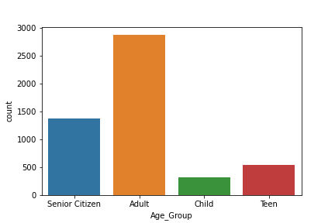
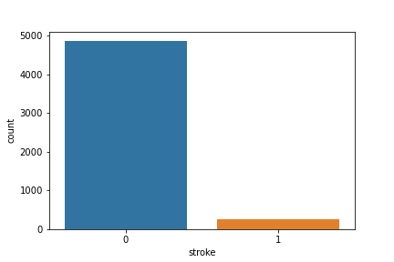
H
I
S
T
O
G
R
A
M

Slide 10
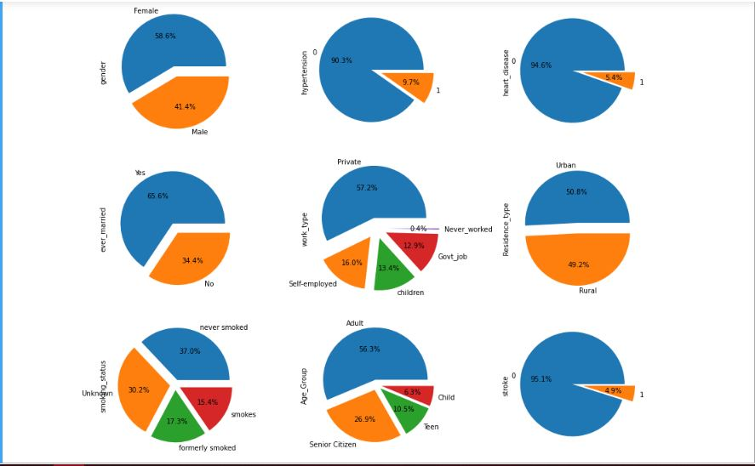
P
I
E
P
L
O
T

Slide 11
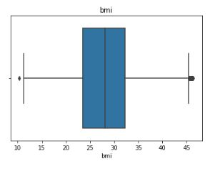
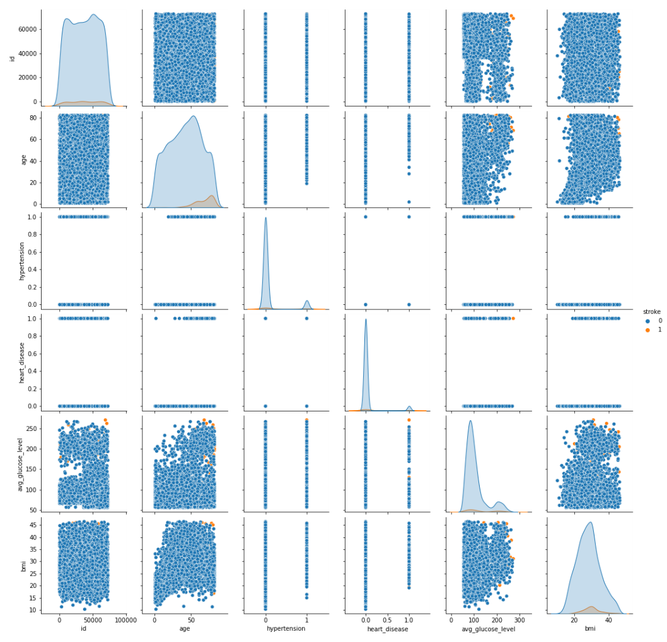
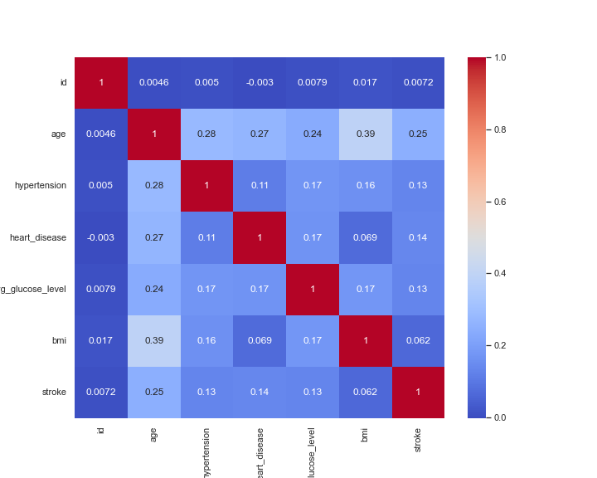
Treating Outliers
Pair Plot
H
E
A
T
M
A
P

Slide 12
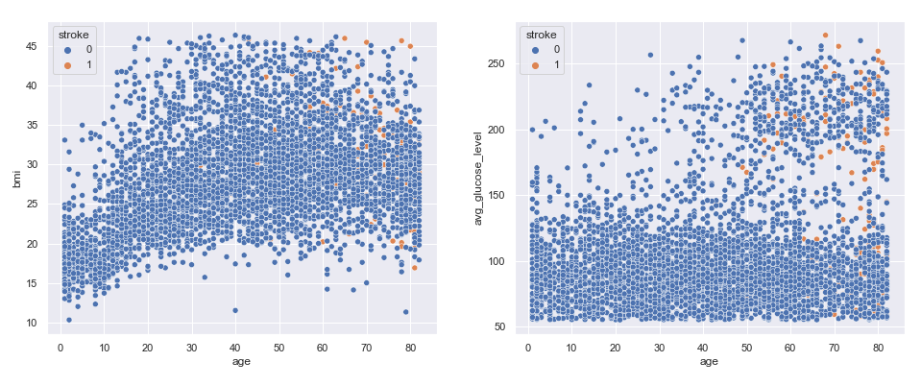
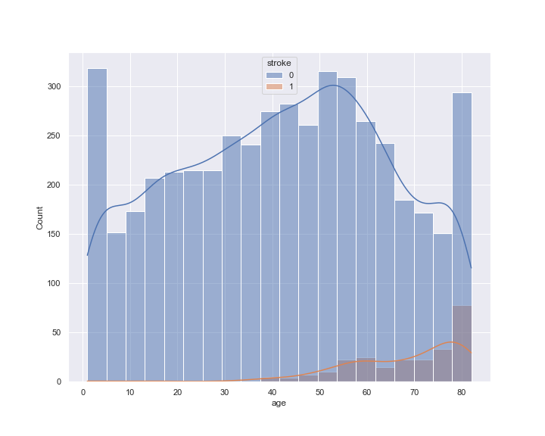
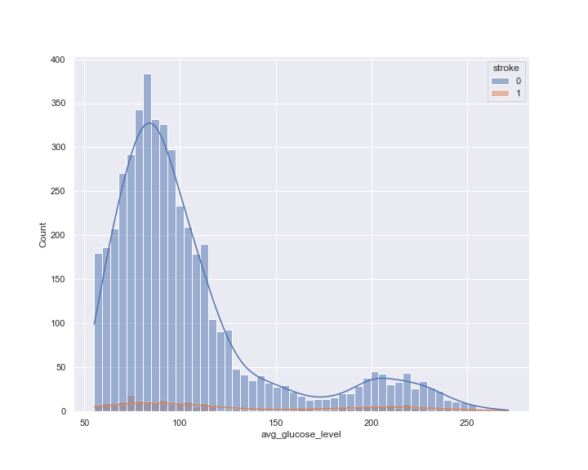
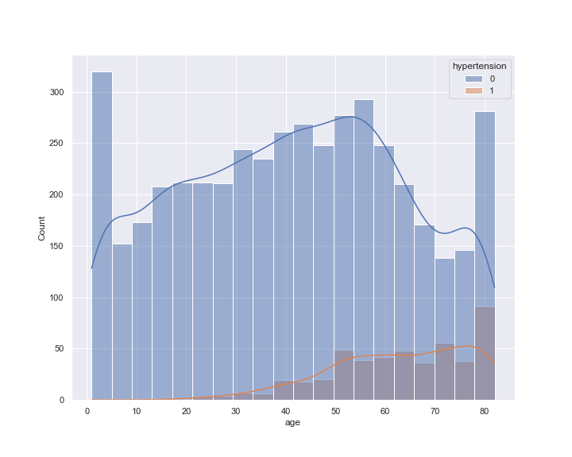
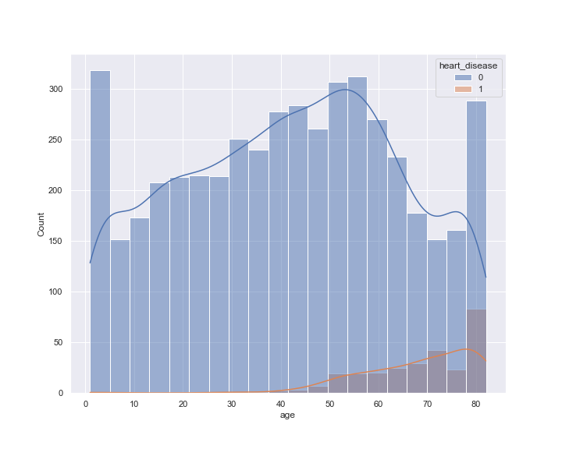
RELATIONSHIP BETWEEN VARIABLES
Continuous Data
V/s
Continuous Data
Categorical Data V/s Continuous Data

Slide 13
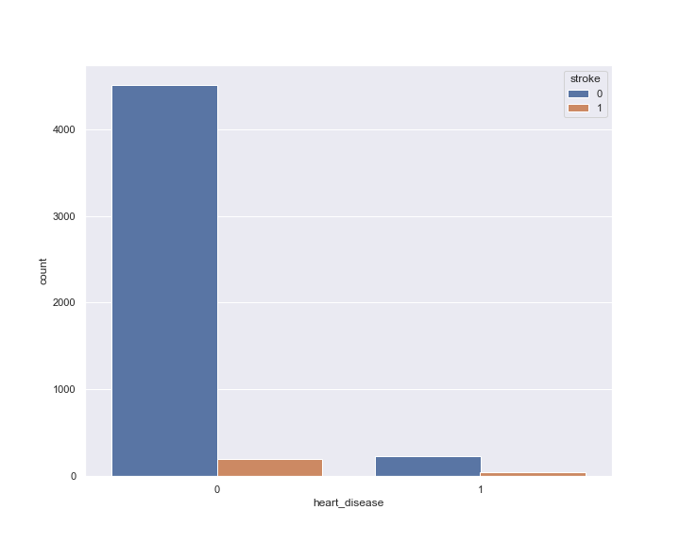
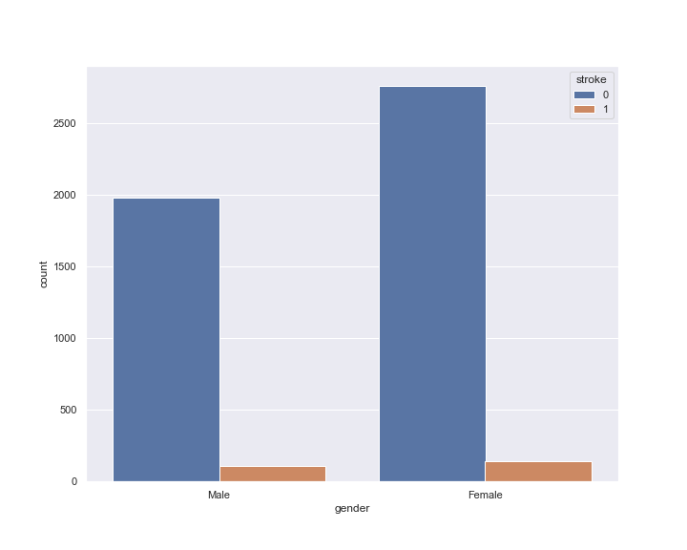
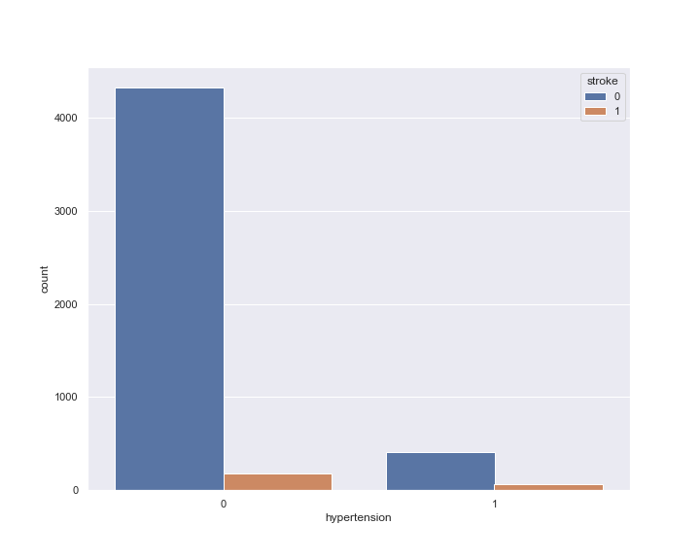
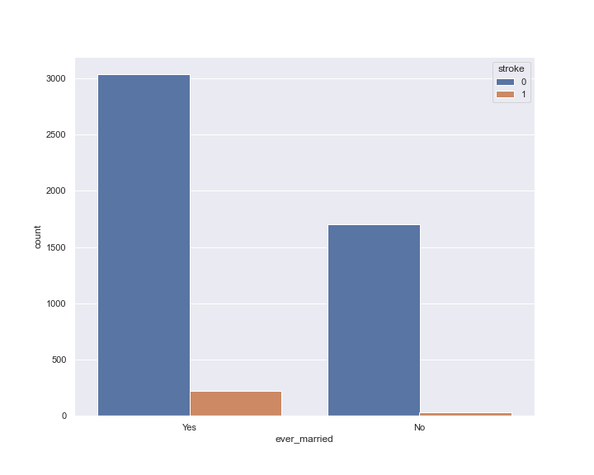
Categorical Data
V/s
Categorical Data

Slide 14
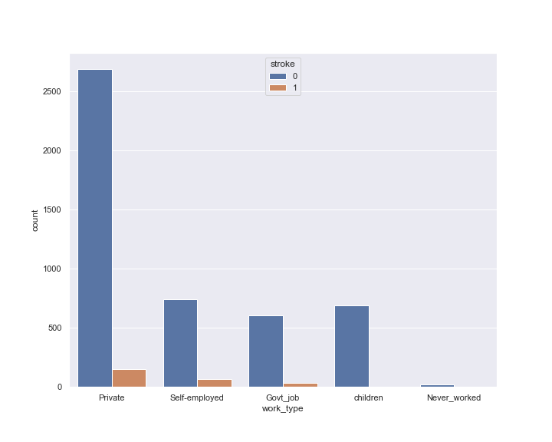
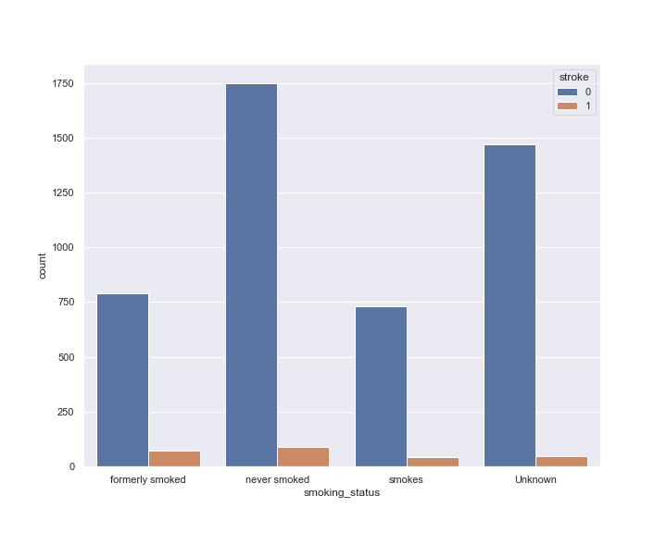
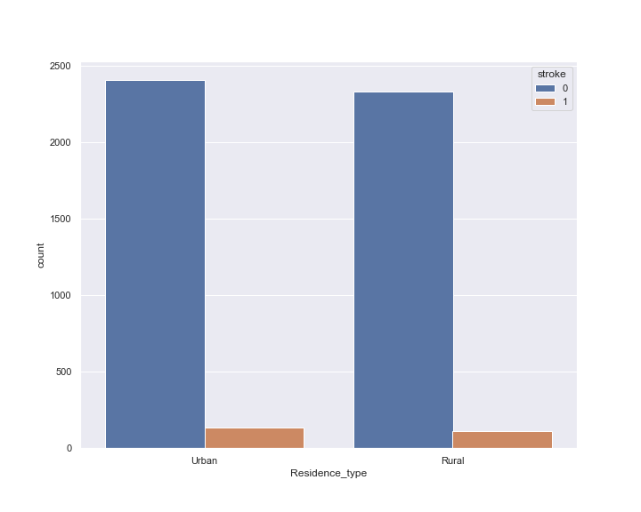
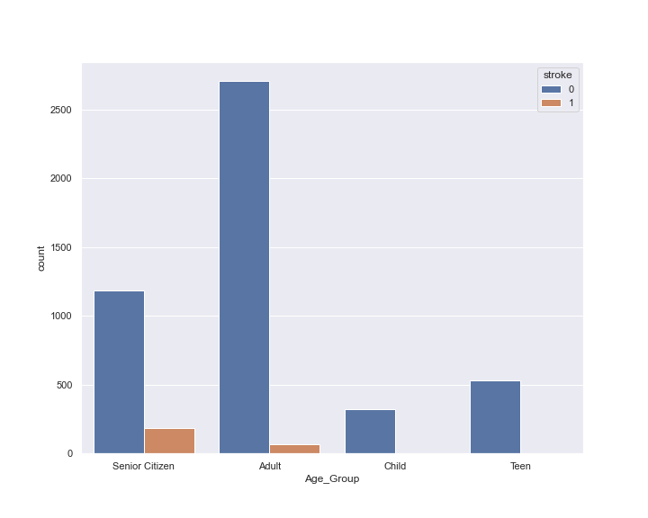
Categorical Data
V/s
Categorical Data

Slide 15
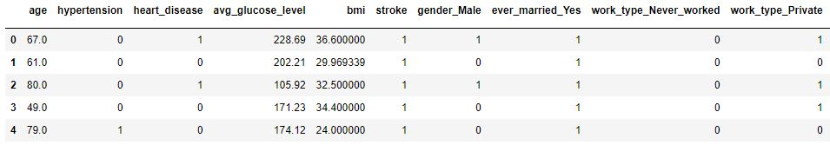
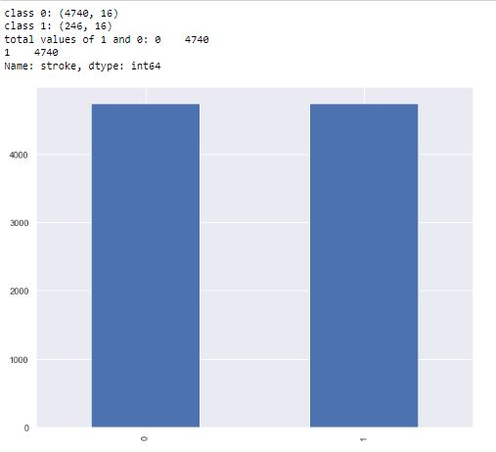
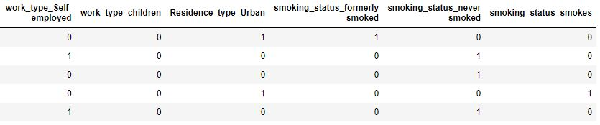
Feature Engineering
Dummy Variables
Over Sampling

Slide 16
Machine Learning Models

Slide 17
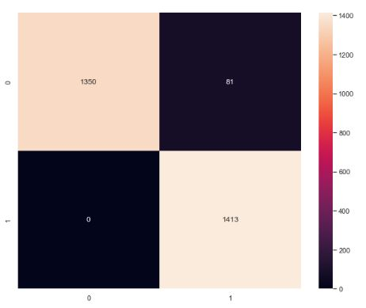
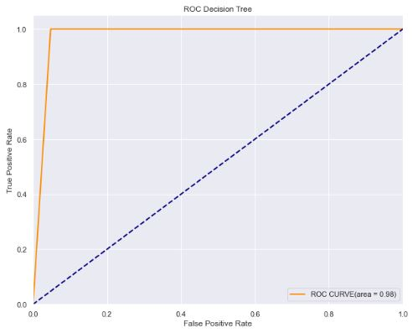

Decision Tree
Library used : sklearn.tree (DecisionTreeClassifier)
Split used for training and testing the data : 70-30
Feature Scaling was performed after splitting the dataset to avoid information leakage on testing dataset by using Standardization method.
Accuracy : 97%
Recall : 0 - 95 %, 1 – 100 %
Precision : 0 – 100 %, 1 – 95%

Slide 18


Random Forest
Library used : sklearn.ensemble (RandomForestClassifier)
Split used for training and testing the data : 70-30
Feature Scaling was performed after splitting the dataset to avoid information leakage on testing dataset by using Standardization method.
Accuracy : 99%
Recall : 0 - 98 %, 1 – 100 %
Precision : 0 – 100 %, 1 – 98%

Slide 19


Logistic Regression
Library used : sklearn.linear_model (LogisticRegression)
Split used for training and testing the data : 70-30
Feature Scaling was performed after splitting the dataset to avoid information leakage on testing dataset by using Standardization method.
Accuracy : 79%
Recall : 0 - 74 %, 1 – 83 %
Precision : 0 – 82 %, 1 – 76%

Slide 20



KNN
Library used : sklearn.neighbors (KNeighborsClassifier)
Split used for training and testing the data : 70-30
Feature Scaling was performed after splitting the dataset to avoid information leakage on testing dataset by using Standardization method.
Accuracy : 97%
Recall : 0 - 95 %, 1 – 100 %
Precision : 0 – 100 %, 1 – 95 %

Slide 21


SVM
Library used : sklearn.svm (SVC)
Split used for training and testing the data : 70-30
Feature Scaling was performed after splitting the dataset to avoid information leakage on testing dataset by using Standardization method.
Kernel = ‘rbf’ , c = 1, gamma = 10
Accuracy : 100%
Recall : 0 - 99 %, 1 – 100 %
Precision : 0 – 100 %, 1 – 99 %

Slide 22


ANN
Library used : keras
Split used for training and testing the data : 70-30
Feature Scaling was performed after splitting the dataset to avoid information leakage on testing dataset by using Standardization method.
Accuracy : 94%
Recall : 0 - 89 %, 1 – 99 %
Precision : 0 – 99 %, 1 – 90 %

Slide 23

Accuracy Comparison
SVM has the highest accuracy among all the models.
SVM model doesn't miss-classifies any Stroke Patient as a Non-Stroke patient. We don't want any patient who is suffering from Stroke to be classified as Non-Stroke and not getting the required medical facilities.

Slide 24
THANKYOU
Saket Trivedi
sakettrivedi@outlook.com
EBEON0122549162
Aalind Kumar Singh
asinghasingh2011@gmail.com
EBEON0122552923
Neha Anwekar
anwekarneha13@gmail.com
EBEON0222516086

